Slide 1
Climate Data Introduction: A Guide to Access, Process, and Link with Demographic Data
Kai Feng
University of Pennsylvania
Quantitative Methodology Working Group
3/15/2024

Slide 2
What kinds of research questions can be asked using climate and demographic data (1)?
Who is at risk, where, and when?
Carr, D., Falchetta, G., & Sue Wing, I. (2024). Population aging and heat exposure in the 21st century: Which US regions are at greatest risk and why?. The Gerontologist, 64(3), gnad050.
Jones, B., O’Neill, B. C., McDaniel, L., McGinnis, S., Mearns, L. O., & Tebaldi, C. (2015). Future population exposure to US heat extremes. Nature Climate Change, 5(7), 652-655.
Feng, K., Laghi, M., Behrman, R. J., Hannum, E., Wang, F,. Rising temperatures, rising risks: a three-decade analysis of children’s heat exposure in China (1990-2020). Working paper
Other risks…by social groups…

Slide 3
What kinds of research questions can be asked using climate and demographic data (2)?
Impacts on population outcomes?
Hanna, R., & Oliva, P. (2016). Implications of climate change for children in developing countries. The Future of Children, 115-132.
Maccini, S., & Yang, D. (2009). Under the weather: Health, schooling, and economic consequences of early-life rainfall. American economic review, 99(3), 1006-1026.
Yang, X., Feng, K., (2023) Mapping the cumulative effects of climate change on children’s education in ten African countries. Global Education Monitoring Report
Other populations…other outcomes…

Slide 4
Common Datasets
ERA5 Reanalysis (rich variables, long and updated time coverage)
Climate Hazards Center (CHIRPS, CHIMES, etc.)(better resolution)
CMIP6 (good for projections, different socio-economic pathways)

Slide 5
Spatial Resolution in Gridded Data
ERA5 Reanalysis: 0.25° x 0.25°
Climate Hazards Center: 0.05° x 0.05°

Slide 6
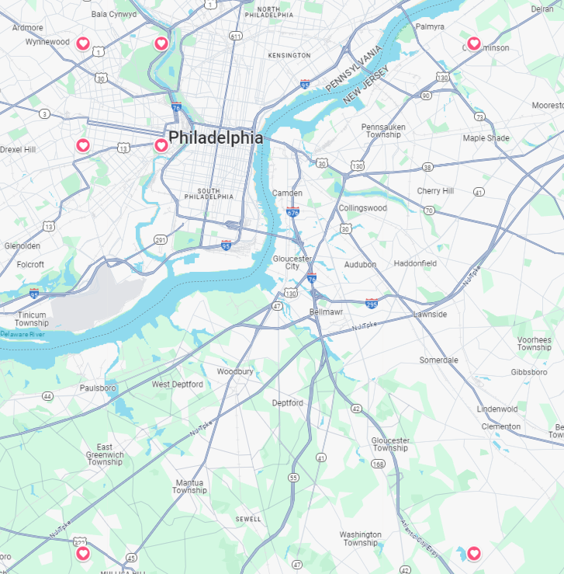
Coord=(Lat, Long) Longitude: West(-), East(+) Latitude: South(-), North(+)
(40.00,-75.25)
(40.00,-75.00)
(??,??)
(39.75,-75.25)
(39.75,-75.00)

Slide 7
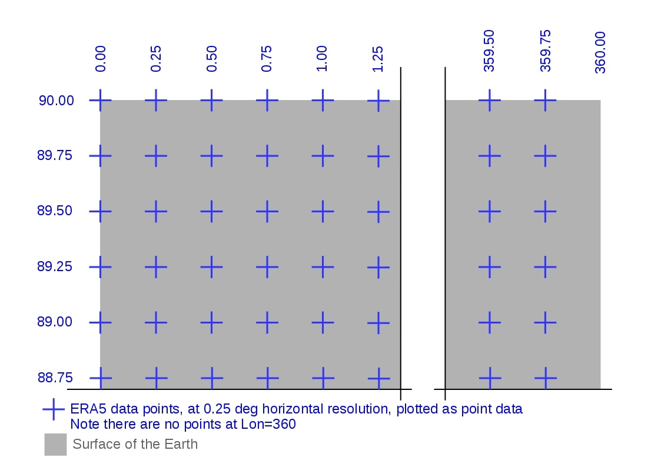
Each coordinate stores coord-specific climate data

Slide 8
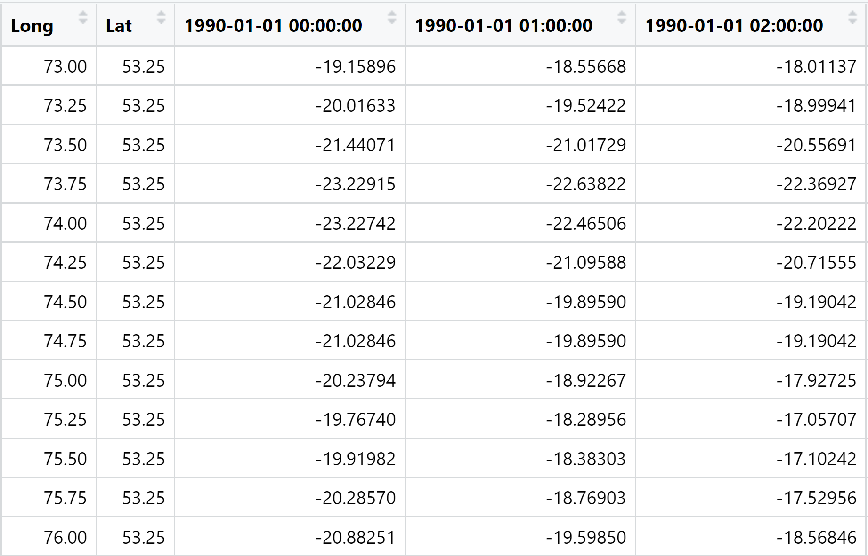
Climate Data structure example: hourly temperature by coordinate

Slide 9
Two Scenarios:
Focused region contains multiple data points
Focused region contains no data point
Typical unit of analysis used for regions: census tract, county, etc.

Slide 10
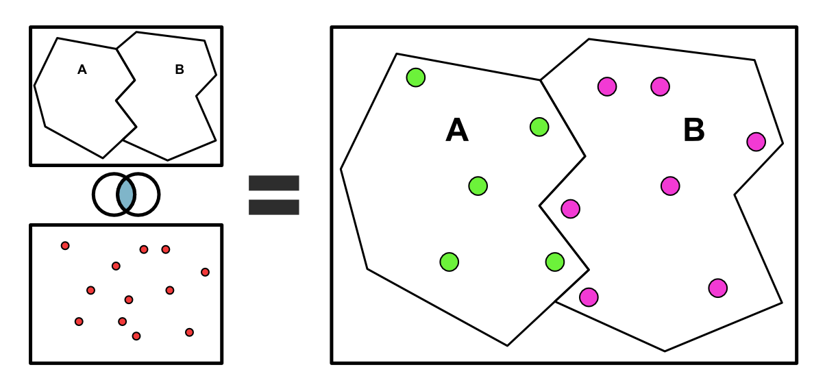
Spatial Join

Slide 11
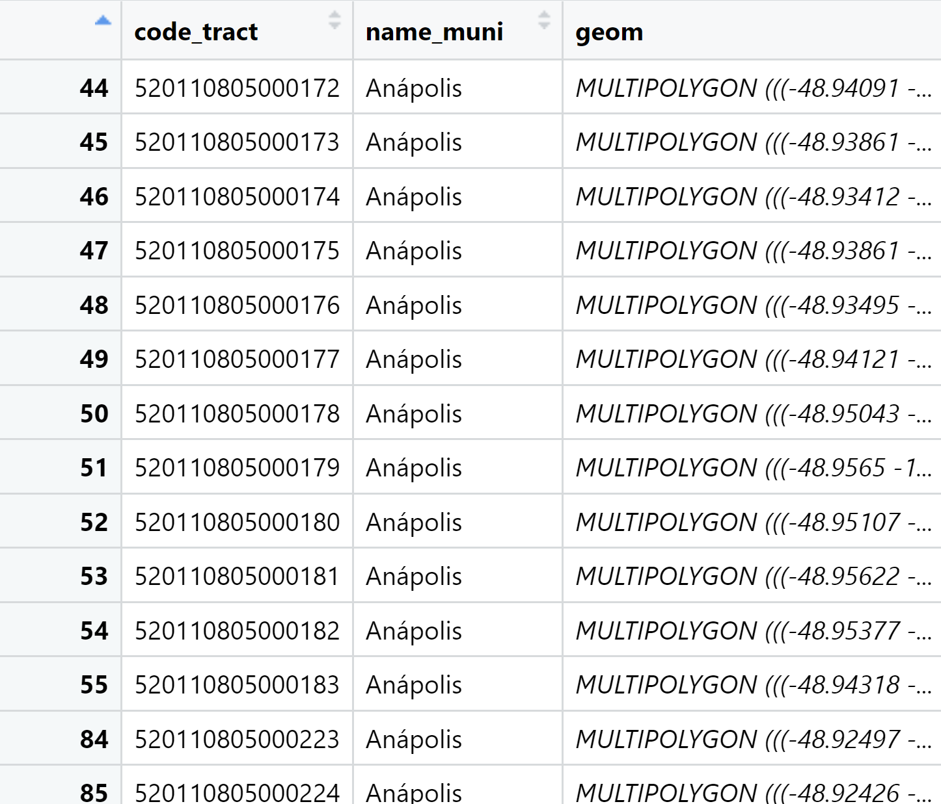
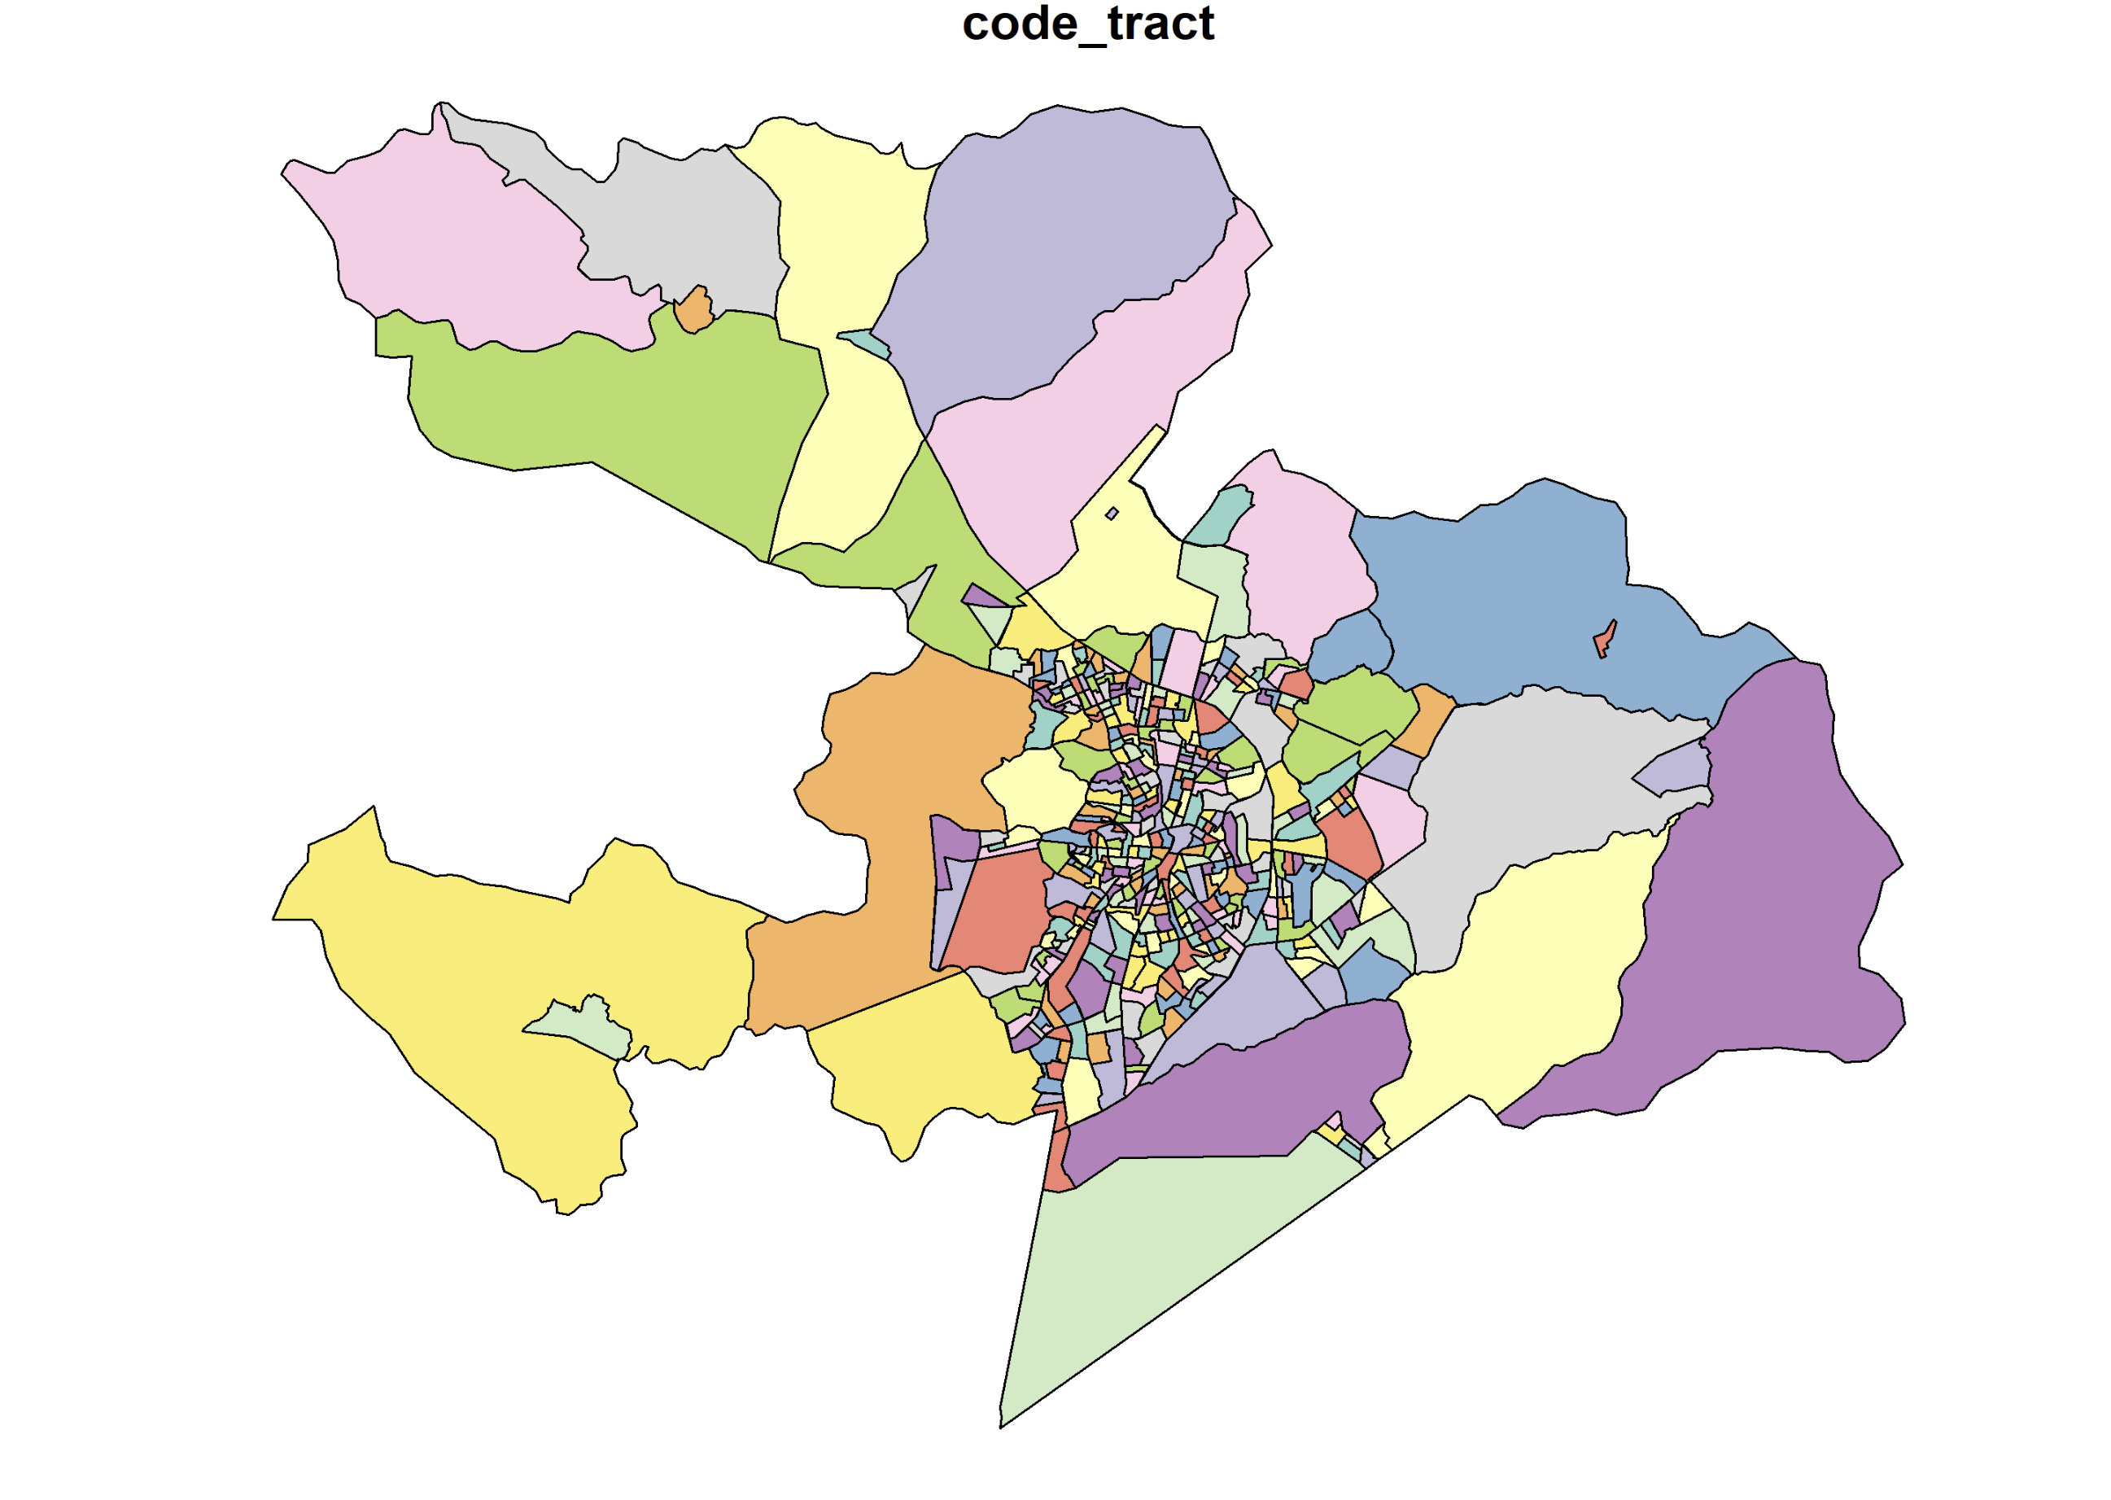
(Geo-Demographic)Data structure example: Census tracts in Anapolis

Slide 12

Access ERA5 data
Register an account from ECMWF (link)
From user profile, find your UID and API Key
Open up an editor (notepad++ for example), create an empty file, paste the url and your UID:APIKEY into the file as below.
Save file in your home directory as:
C:/Users/ YourUsername/.cdsapirc (win)
/Users/YourUsername/.cdsapirc (macOS)
UID:APIKEY

Slide 13
Access ERA5 data
Install Anaconda for python 3
Open up anaconda prompt with admin rights (right click choose as admin).
Copy the following lines to the anaconda prompt
# Set up
conda deactivate
conda list env
conda env remove -n wk_ecmwf
conda create -n wk_ecmwf -y
conda activate wk_ecmwf
# Add conda-forge to channel in env
conda config --env --add channels conda-forge
conda config --get channels
conda config --get channels --env
# Install
conda install cdsapi -y
conda install -c anaconda pandas
conda install -c conda-forge eccodes -y
conda install -c conda-forge cfgrib -y
conda install -c anaconda xarray -y
conda install -c conda-forge netCDF4
Also see here for more detailed instruction (link)

Slide 14
Example: download UTCI data from ERA5-HEAT
GitHub: ear5_utci.py
Install Visual Studio Code, a commonly used cross-platform code editor
Open ear5_utci.py using VS Code
Enable Python extension in VS Code and it will auto auto-detect the environment created
Note that UTCI is a heat index not the temperature per se.
Visit the Climate Data Store for more data product

Slide 15
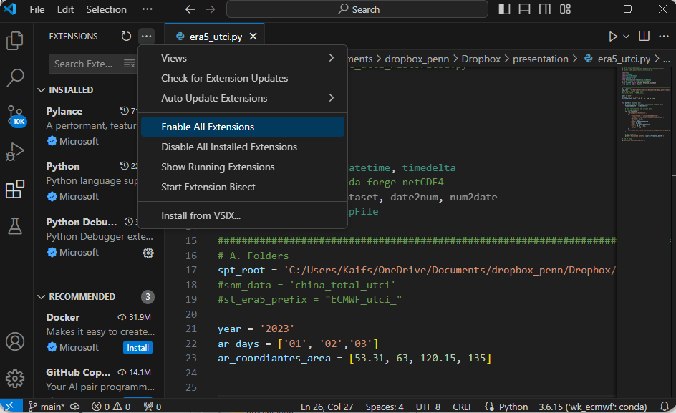
Enable all extensions (python extension) ctrl+shift+x or go to View > Extensions
You will see this if python environment has been successfully installed.

Slide 16
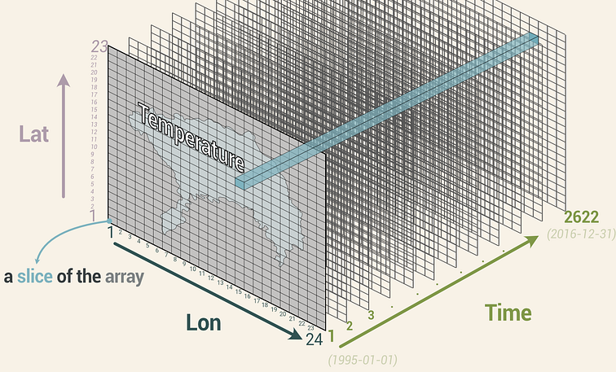
NetCDF data format
commonly used in storing multidimensional data such as climate model output (3-dimention)
How to process? Tutorial
GitHub: pa_utci_join.r

Slide 17
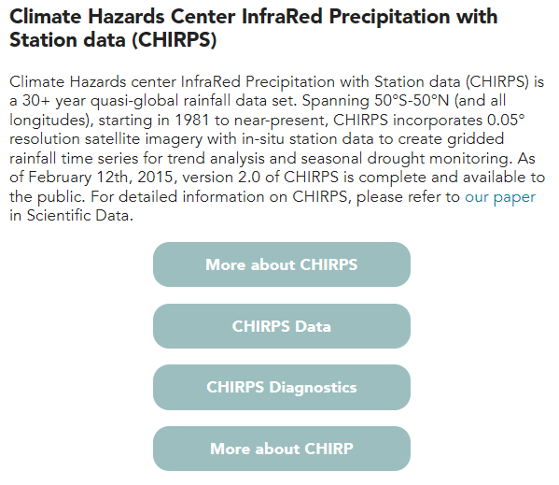
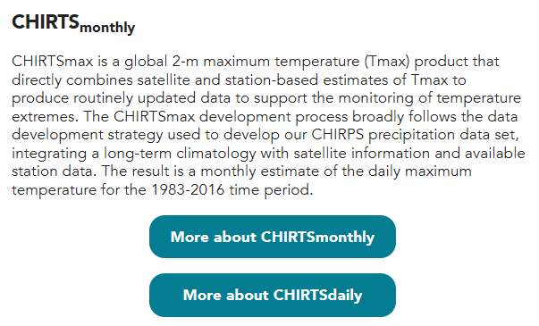
Climate Hazards Center at UCSB(link) be aware, poorly documented

Slide 18
CHIRPS R package
API Client for CHIRPS and CHIRTS • chirps (ropensci.org)

Slide 19
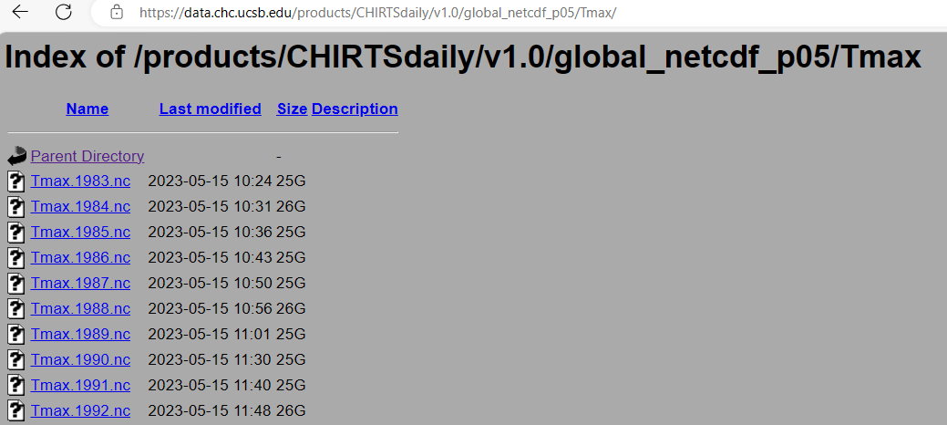
Extract all files at once
GitHub: download_CHIRPS.py

Slide 20
Other Demographic Data with Geo-code
Demographic and Health Surveys
Multiple Indicator Cluster Surveys
There will be one online workshop on March 20 about MICS GIS
Currently no space for new register, but recording will be posted on YouTube.

Slide 21
DHS (unit of analysis: cluster)
To ensure confidentiality, DHS randomly displace the GPS positions for all surveys.
Urban clusters contain a min of 0 and a max of 2 km of error.
Rural clusters contain a min of 0 and a max of 5 km of positional error with a further 1% of the rural clusters displaced a min of 0 and a max of 10 km.
Further read:
Burgert et al. (2013). Geographic displacement procedure and georeferenced data release policy for the Demographic and Health Surveys. Icf International.
Grace et al. (2019) Integrating environmental context into DHS analysis while protecting participant confidentiality: A new remote sensing method. PDR, 45(1), 197.

Slide 22
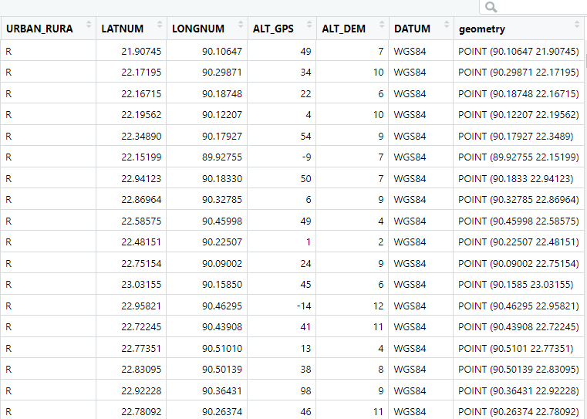
DHS GIS file structure (each line is one cluster)
How to link DHS with climate data?
Based on rural/urban status, create a 10 km or other-size buffer around each coordinate (follow DHS recommendations and literature)
Spatial average the climate data points within the buffer as proxy for the cluster

